Slide 1



Lifestyle Assurance™
Guarantee Issue Critical Illness Insurance
Presented by: Leo D. Barrera

Slide 2

A Word About the Past…
“More than 25 years ago, I had a dream to provide money for those patients who had been diagnosed with a critical illness. Critical Illness insurance was the result. After a slow start, it is today recognized as the protection policy of the new millennium and millions of policies are sold throughout the world.”
- Excerpt from “Defining Moments” by Dr. Marius Barnard

Slide 3
Lifestyle Assurance™
A Guarantee Issue Health Chassis Critical Insurance plan which pays lump sum benefits upon first diagnosis of a covered critical illness.*
Coverage available for individuals, individuals w/ kids, individuals & spouse, and the entire family.
Each covered person’s benefit amount decreases by 35% of the benefit amount at age 65 and decreases an additional 15% at age 70. Premium is not reduced as a result of these decreases.
Premiums based on Age & Tobacco Status Only. Tobacco look back is 12 MO.
2 Simple Benefit Options to Choose From: $5k, $10K
The possibility of surviving a critical illness before age 65 is almost twice as great as dying.
*Exclusions Apply. See Policy for Details.

Slide 4
Lifestyle Assurance™
Covered Conditions
100% benefit payable upon diagnosis* on or after 30th day (90th day for Cancer) coverage becomes effective of the following covered conditions:
Each covered person’s benefit amount decreases by 35% of the benefit amount at age 65 and decreases an additional 15% at age 70. Premium is not reduced as a result of these decreases.
Stroke
Heart Attack
Invasive Cancer
Terminal Illness
Major Organ Transplant
End Stage Renal Failure
Some exclusions and exceptions apply. Benefits may differ or not be available in some states, your agent will explain the benefits available in your state. Partial Benefits paid out are deducted from the policy face amount. The policy may continue in force at the adjusted Face Amount and reduced insurance premium.
Except suicide during the first two years, Missouri 3 years, North Dakota and Colorado 1 year. The policy terminates after a full benefit is paid out. Covered conditions and percentages of benefits payable vary by state. Covered conditions are defined in the policy. The summary contained in this piece is only an overview of the actual definitions. The actual policy definitions should be consulted and will control.
** Not available in all states.
*If CBL approves the application and the first premium is paid, or the payroll deduction is authorized, coverage will begin as of the date the application is signed.
*Waiting periods may vary by state.

Slide 5
Lifestyle Assurance™
Covered Conditions
Percentage of benefits payable upon diagnosis* on or after 30th day (90th day for Cancer) coverage becomes effective of the following covered conditions:
25%:
Carcinoma in Situ
Major Heart Surgery
10%:
Angioplasty
Skin Cancer Benefit:
$250 For Primary Insured
$250 For Insured Spouse
$75 For Each Insured Child
Approximately 780,000 people suffer strokes each year.
60% of stroke victims are Women.
70% of open heart surgery operations each year are coronary bypasses.
75% of stroke victims survive the initial occurrence.
What it means? Better chances at living, lower chances of surviving financially.

Slide 6




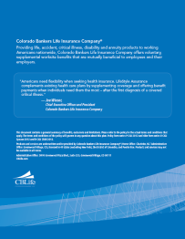
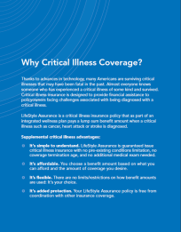
Product Brochure

Slide 7
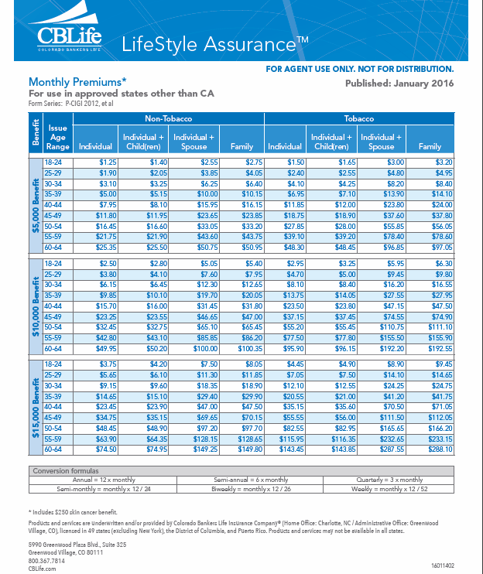
Incredible Rates!!!
**NOTE **
$15K Benefit is Not Approved YET!!!
State Specific Rates - CA

Slide 8
APPOINTED?
CALL 1-888-455-7462
APPROVED STATES | APPROVED STATES
ALASKA | ALABAMA
ARKANSAS | CALIFORNIA
WASHINGTON D.C. | DELAWARE
HAWAII | IOWA
IDAHO | ILLINOIS
LOUSIANA | MAINE
MICHIGAN | MISSOURI
MISSISSIPPI | MONTANA
NORTH CAROLINA | NORTH DAKOTA
NEBRASKA | NEW MEXICO
OKLAHOMA | PENNSYLVANIA
TENESSEE | TEXAS
WISCONSIN | WEST VIRGINIA
WYOMING | **MORE COMING SOON!***

Slide 9


Protect All of Your Clients
Existing Clients
Self-Employed
Payroll Deduction (Portable Benefits!)
Singles
House spouses
Disability Supplement
Family Protection
College Funding
First Responders
Uninsured/Underinsured
Part Timers/Unemployed
IT’S GUARANTEE ISSUE!!!

Slide 10

Why C.I.???
Co-Pays & Deductibles
Lost Income of Self/Spouse
Daily Living Expenses/Responsibilities
Experimental Treatments
Travel/lodging for treatment(s)
Home Health Care/Cost of Caregivers
Housekeeping or Child Care expenses
Maintenance of your Family’s Quality of Life!

Slide 11
Want to Sell Online?
Complete your Licensing Packet (Contact your GA for Licensing & Contracting Information)
Send completed forms to: Laurie@cbsinsurance.net or Fax: 480-706-4507
** Ask About an Agent Welcome E-mail.**
Call us Toll Free
1-888-455-7462
Or
E-mail:
Leo@cbsinsurance.net
Jeremy@cbsinsurance.net

Slide 12
Thank You!
Questions?
Why C.I.?
…Because a Check is Better than a Get Well Card!

